Slide 1

Tablet vs Paper: how to take notes sustainably
Meike knull
kristina svetova
Timo koski

Slide 2
Image credit voicesofyouth VoY, source

Slide 3
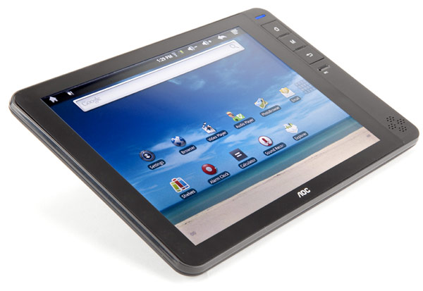


This Photo by Unknown Author is licensed under CC BY-SA-NC
This Photo by Unknown Author is licensed under CC BY
This Photo by Unknown Author is licensed under CC BY-SA

Slide 4
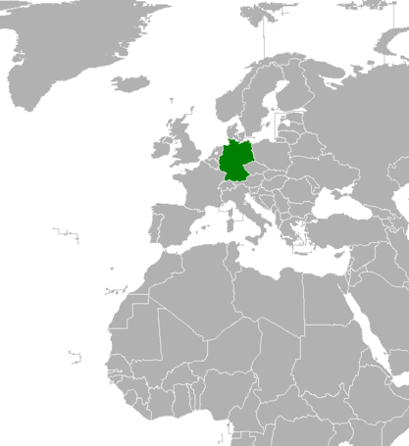
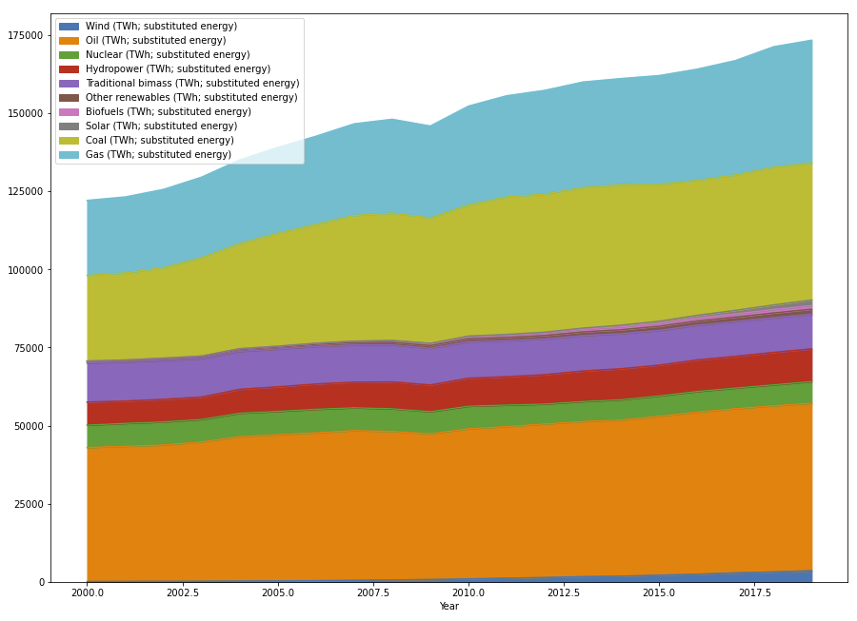
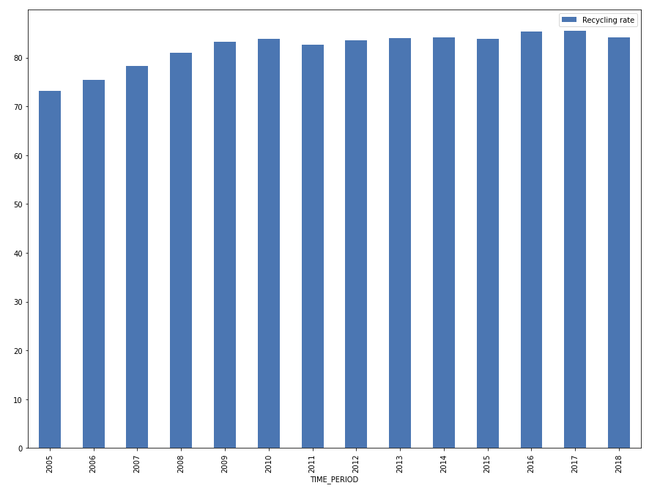
Volume and share of energy production types
Recycling rate of paper
This Photo by Unknown Author is licensed under CC BY-SA

Slide 5
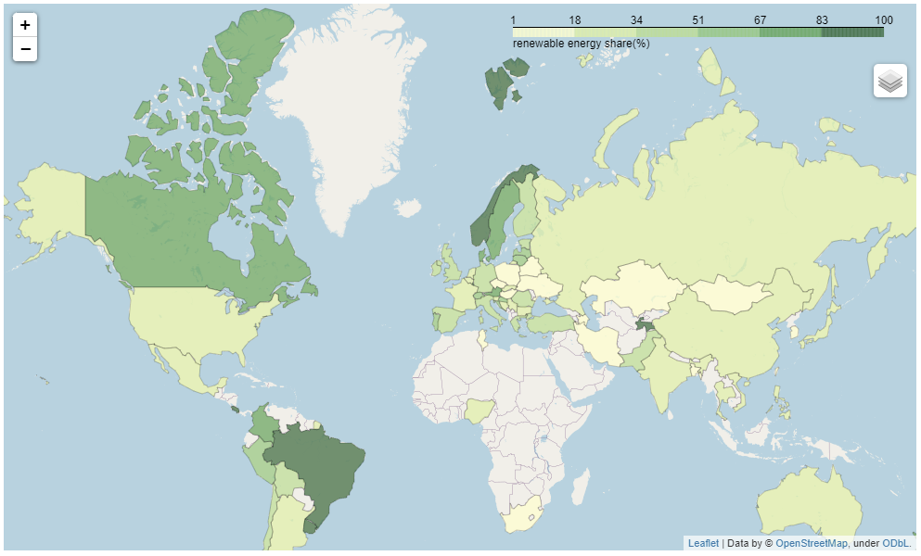
Volume and share of energy production types
Recycling rate of paper

Slide 6

Release date 1.11.2021

Slide 7
Thank you!

